Slide 1

“Fundamental Rights In the
Indian Constitution ”

Slide 2


Slide 3

DEFINITION
Fundamental Rights are essential human rights that are offered to every citizen irrespective of caste, race, creed, place of birth, religion or gender. These are equal to freedoms and these rights are essential for personal good and the society at large.

Slide 4

SIX FUNDAMENTAL RIGHTS
The Right to EQUALITY
The Right to FREEDOM
The Right to Freedom from EXPLOITATION
The Right to FREEDOM OF RELIGION
CULTURAl and EDUCATIONAL Rights
The Right to CONSTITUTIONAL REMEDIES

Slide 5


RIGHT TO EQUALITY

Slide 6
RIGHT TO EQUALITY
(i) Equality before Law :- Article 14 of the constitution guarantees that all citizens shall be equally protected by the laws of the country
(ii) Social equality and equal access to public areas:- Article 15 of the constitution states that no person shall be discriminated on the basis of caste, colour, language etc. Every person shall have equal access to public places like public parks, museums, wells, bathing ghats and temples etc. However, the State may make any special provision for women and children.

Slide 7
RIGHT TO EQUALITY
(iii) Equality in matters of public employment:- Article 16 of the constitution lays down that the State cannot discriminate against anyone in the matters of employment. All citizens can apply for government jobs.
(iv) Abolition of untouchability :- Article 17 of the constitution abolishes the practice of untouchability. Practice of untouchability is an offense and anyone doing so is punishable by law.
(v) Abolition of Titles:- Article 18 of the constitution prohibits the State from conferring any titles. Citizens of India cannot accept titles from a foreign State.

Slide 8


RIGHT TO FREEDOM

Slide 9
RIGHT TO FREEDOM
(i) Freedom of Speech and expression, which enable an individual to participate in public activities. The phrase, "freedom of press" has not been used in Article 19, but freedom of expression includes freedom of press.
(ii) Freedom to assemble peacefully without arms, on which the State can impose reasonable restrictions in the interest of public order and the sovereignty and integrity of India.
(iii) Freedom to form associations or unions on which the State can impose reasonable restrictions on this freedom in the interest of public order, morality and the sovereignty and integrity

Slide 10
RIGHT TO FREEDOM
(iv) Freedom to move freely throughout the territory of India though reasonable restrictions can be imposed on this right in the interest of the general public, for example, restrictions may be imposed on movement and travelling, so as to control epidemics.
(v) Freedom to reside and settle in any part of the territory of India which is also subject to reasonable restrictions by the State in the interest of the general public or for the protection of the schedule tribes because certain safeguards as are envisaged here seem to be justified to protect indigenous and tribal peoples from exploitation and coercion.

Slide 11
RIGHT TO FREEDOM
(vi) Freedom to practice any profession or to carry on any occupation, trade or business on which the State may impose reasonable restrictions in the interest of the general public. Thus, there is no right to carry on a business which is dangerous or immoral.

Slide 12
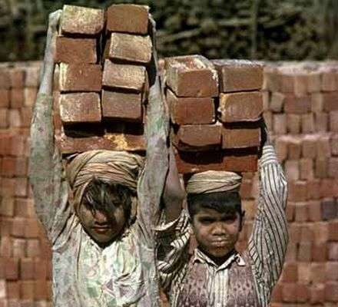
RIGHT AGAINST EXPLOITATION

Slide 13
RIGHT AGAINST EXPLOITATION
The abolition of trafficking in human beings and Begar (forced labour)
Abolition of employment of children below the age of 14 years in dangerous jobs like factories and mines.
Begar, practised in the past by landlords, has been declared a crime and is punishable by law
Trafficking in humans for the purpose of slave trade or
prostitution is also prohibited by law.

Slide 14
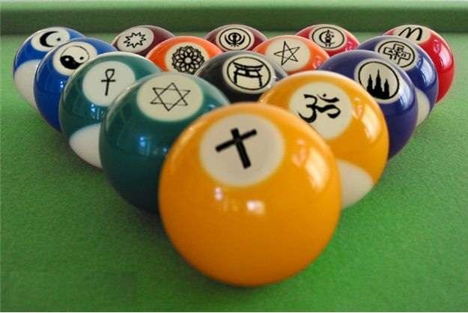
RIGHT TO FREEDOM OF RELIGION

Slide 15
RIGHT TO FREEDOM OF RELIGION
According to the Constitution, all religions are equal before the State and no religion shall be given preference over the other. Citizens are free to preach, practice and propagate any religion of their choice.
Religious communities can set up charitable institutions of their
own.
Activities in such institutions which are not religious are performed according to the laws laid down by the government
No person shall be compelled to pay taxes for the promotion of a particular religion.
A State run institution cannot impart education that is pro- religion

Slide 16


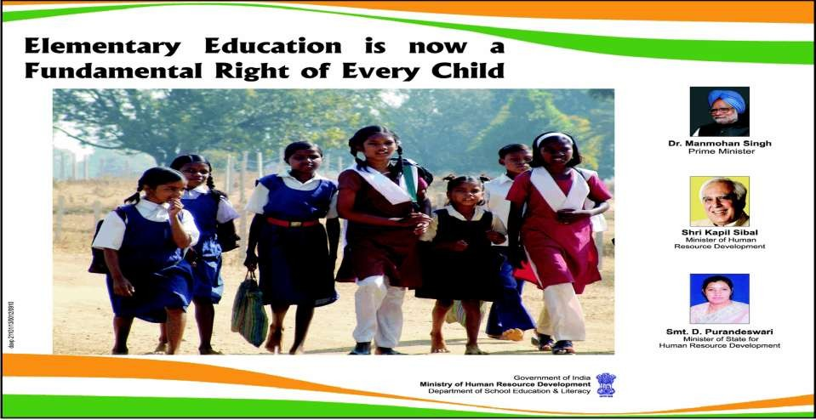
CULTURAL EDUCATIONAL RIGHTS

Slide 17
CULTURAL EDUCATIONAL RIGHTS
ARTICLES 29 & 30
Any community which has a language and a script of its own has the right to conserve and develop it.
All minorities, religious or linguistic, can set up their own educational institutions to preserve and develop their own culture.

Slide 18


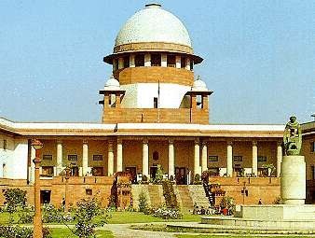
RIGHT TO CONSTITUTIONAL REMEDIES

Slide 19

RIGHT TO CONSTITUTIONAL REMEDIES5
Right to constitutional remedies empowers the citizens to move a court of law in case of any denial of the fundamental rights.
This procedure of asking the courts to preserve or safeguard the citizens' fundamental rights can be done in various ways. The courts can issue various kinds of writs. These writs are habeas corpus, mandamus, prohibition, quo warranto and certiorari.

Slide 20








Slide 21


THANK YOU

